Slide 1

Getting
to nirvana
Or how to scale out your GTM
Caroline Clark

Slide 2
Read me
I’ve worked in go-to-market at Atlassian as one of the first GTM hires on Jira Service Desk (now the second largest product), and venture capital at Sequoia. Now I am building something new.
So many founders ping me asking: “What should my GTM strategy be” and “How do I build slides about that”?
I looked around for an overview, and couldn’t find a great and accessible one to send over. So I decided to build this deck as an open resource to give back.
Specifically, this is meant for founders who are figuring out their go-to-market for B2B companies. Feel free to copy these slides and modify for your needs.
Ping @carolinedclark on Twitter with feedback, questions, etc.

Slide 3
First things first,
the product has to be great.
It’s miserable trying to sell or market a product that isn’t useful.

Slide 4
GTM strategy is like legos that form a whole.
You will need to figure out internal questions in order to get answers.

Slide 5

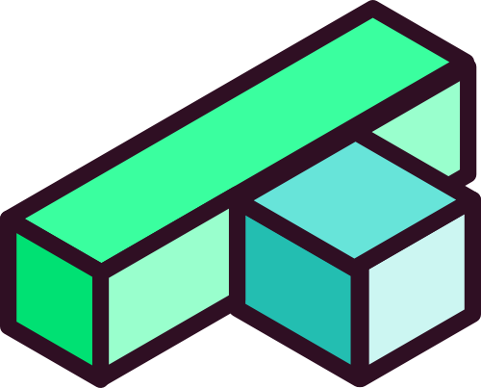


This deck focuses on the legos

Slide 6
GTM strategy
Who is the
ideal customer?
How are you
going to reach them?
How are you
going to scale?
Buyer personas
Pricing
Payment models
(freemium/free trial/demo)
LTV,
CAC
Market size
Acquisition channels

Slide 7
GTM strategy
Who is the
ideal customer?
How are you
going to reach them?
How are you
going to scale?
Buyer personas
Pricing
Payment models
(freemium/free trial/demo)
LTV,
CAC
Market size
Acquisition channels

Slide 8
All sales start with a buyer.
Regardless of whether it’s bottoms up or high touch sales.

Slide 9
Why do buyer personas matter?
They can help figure out who matters, and help you prioritize your time accordingly.

Slide 10
“I should have spent more time on finding out who the typical buyer of Front is. Without this information, outbound or paid acquisition cannot be successful.”
- Mathilde Collin, Front

Slide 11
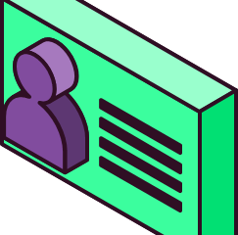



What’s an example of a buyer persona?
 |  |  | Target buyers
 |  |  | Developers
 |  |  | Designers
 |  |  | Infrastructure
Who are they?
They seem
quite obvious ▶

Slide 12


But you can get deeper.
Who are they really?
 | Job title |  | What is their title?
 | Stage of company |  | How mature is their company?
 | Daily activities |  | What do they do? What do they care about?
 | Pain points |  | What is hard about their job?
 | Willingness to pay (WTP) |  | Do they want to spend money?
 | Things to watch out for |  | How influential is this role?

Slide 13
Example buyer personas:
For a GTM product
 |  |  | The founder CEO | The Sales Leader | The Sales Ops / Engineer
 | Stage |  | Early stage (PreSeed/Seed) | Growth (Series A+) | Growth (Series B+)
 | Priorities |  | Building & selling & recruiting | Selling & building out team | Optimizing process & investing in tech stack
 | Pain points |  | Finding PMF and figuring out when they hit it | Getting high quality leads and converting them | Separating signal from noise; getting the right data
 | Willingness to pay (WTP) |  | Low | Medium | High
 | Things to watch out for |  | High enthusiasm for your idea, low WTP | Skeptic, but can be excited once they experience value | Not on sales team; separated from what is actually useful

Slide 14
Worksheet:
Fill in your buyer personas
 |  |  | Persona 1 | Persona 2 | Persona 3
 | Stage
 | Priorities
 | Pain points
 | Willingness to pay (WTP)
 | Things to watch out for

Slide 15
How do you determine price?
How do you determine a buyer persona?
 | Qualitative | Quantitative
Primary Research (customer facing) | Customer interviews - notice patterns in roles and responsibilities Panels/dinners - gather customers in a group and get them to talk about their jobs | Survey to user base Survey to market | If you’re an early stage startup, you usually only need customer interviews
Secondary Research (internal) | Competitive analysis - of the other products in your category, what use cases and teams are they targeting on their website? | Lead data - Segment your customers by these attributes

Slide 16
GTM strategy
Who is the
ideal customer?
How are you
going to reach them?
How are you
going to scale?
Buyer personas
Pricing
Payment models
(freemium/free trial/demo)
LTV,
CAC
Market size
Acquisition channels

Slide 17
Acquisition: Flywheel model?
In an ideal world, your company only relies on a flywheel model of growth - in other words, organic growth through word of mouth or inherent virality of your product. Here’s a great article about Atlassian’s flywheel and Lenny Rachitsky has written about flywheels across companies.
But almost all companies, including Atlassian, have multiple acquisition channels as the company matures.

Slide 18

Acquisition
Channels
 | Channel |  | Who / What
 | Friends and family |  | Founder networks
 | Referrals |  | Word of mouth and formal referral programs
 | Email |  | Welcome emails; onboarding emails; campaigns to convert users
 | Customer community |  | Slack channel; can expedite word of mouth
 | Watercooler communities |  | HackerNews; ProductHunt; Reddit; Vertical specific communities
 | Reseller/Partners |  | Third party integrations; Working with “experts” / ”partners”
 | SEO/Content |  | Discoverable content by searching for keywords
 | Outbound |  | Sales/marketing/growth teams
 | SEM |  | Paid search terms; good for competitor searches
 | Digital ads |  | Showing targeted ads across web properties
Earlier
stages
Later
stages

Slide 19

Worksheet:
Fill in your acquisition channels
 | Channel |  | Who / What
Earlier
stages
Later
stages

Slide 20
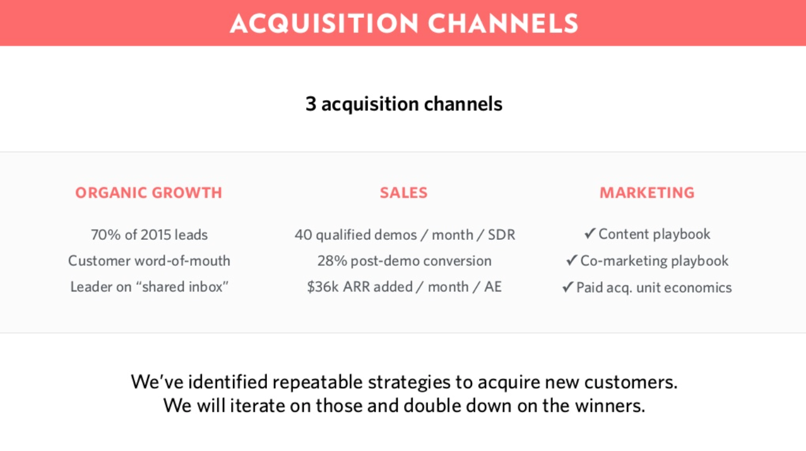

Example acquisition slide:
Front

Slide 21
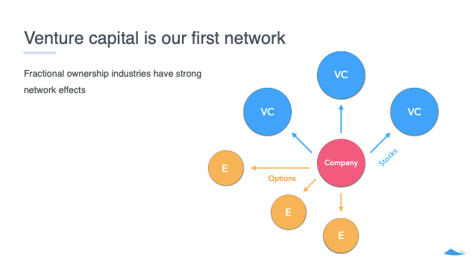

Example acquisition slide:
Carta

Slide 22
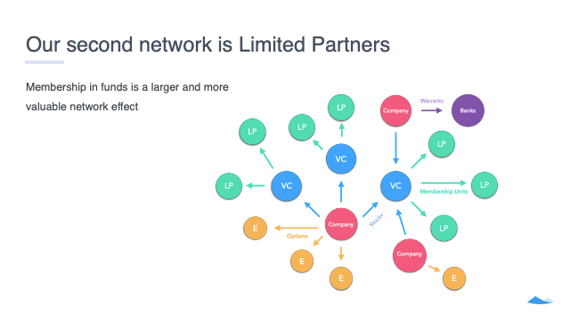
Example acquisition slide:
Carta

Slide 23
GTM strategy
Who is the
ideal customer?
How are you
going to reach them?
How are you
going to scale?
Buyer personas
Pricing
Payment models
(freemium/free trial/demo)
LTV,
CAC
Market size
Acquisition channels

Slide 24
Scale
Scale is a lot of things, but in a GTM context, it’s thinking about efficiency with each net new customer.
Efficiency can be driven by a lot of things. It’s an output of payment models (and by extension, pricing), and costs of acquiring customers (which acquisition feeds into).
In fancier terms, this is the “lifetime value” (LTV) and “customer acquisition costs” (CAC).

Slide 25
 |  | Freemium / ”Self service” |  | Free trial / ”Self service” |  | Demo
% of the market* |  | 38% |  | 22% |  | 66%
What it is |  | Free product until a feature/employee size upgrade |  | Free trial for a week/ two weeks/month |  | Schedule a demo to learn more about product
Examples |  | Slack, Notion, Zoom, Figma |  | Atlassian, Affinity, Snowflake, Fivetran, Gusto |  | Lattice, Snowflake, Front
Benefits |  | Product driven growth, encourages virality |  | Show benefit quickly |  | Control the story; explain product in more detail; higher ACVs
Cons |  | Challenge to upsell; churn/replacement with diff product |  | Lack of relationship with customers → disconnected product and CX teams |  | It can mask lack of product market fit
Takeaway |  | For consumers who may use it for business, or developer/PM buyers, or collaboration products (virality) |  | Like freemium (developers), but with slightly more complex products Makes sense for SMB |  | Useful for Enterprise and products that require onboarding
VS
VS
*Analysis of the top 50 companies in the 2020 Forbes Cloud 100, which represents the top growth stage private companies. All sell to B2B. Numbers do not add up to 100% because most companies combine strategies.

Slide 26
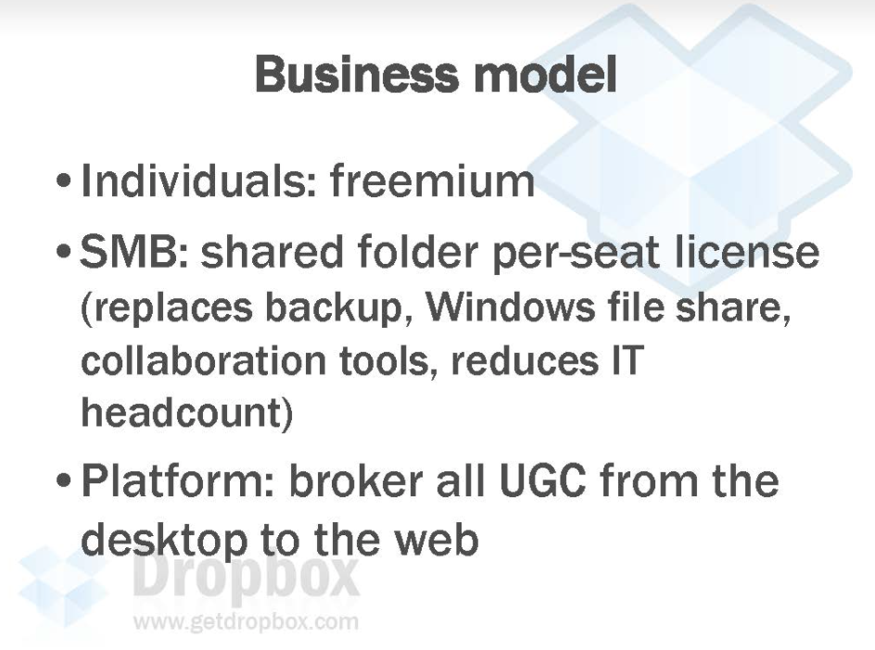

Example freemium payment model:
Dropbox

Slide 27
Pricing
Pricing is kind of a dark art that needs a deck in itself.
Thankfully there are a lot of experts, and Lenny Rachitsky has written up great content on this, and a worksheet on it.

Slide 28
Core elements of pricing
Metric
Structure
Level
What are you going to charge per?
Per user?
Per Gb?
Per device?
“Fencing metrics” are binary & less effective
E.g. access to advanced features, premium support, etc.
How does price relate to time and volume?
Time: intro discounts, freemium, free trial, implementation fees, etc.
Volume: discount tiers, regressive pricing (e.g. taxes), caps, etc.
The actual price point: e.g. $9.99 vs. $10.99

Slide 29
Metric is more important than level
Metric
Structure
Level
What are you going to charge per?
Per user?
Per Gb?
Per device?
“Fencing metrics” are binary & less effective
E.g. access to advanced features, premium support, etc.
How does price relate to time and volume?
Time: intro discounts, freemium, free trial, implementation fees, etc.
Volume: discount tiers, regressive pricing (e.g. taxes), caps, etc.
The actual price point: e.g. $9.99 vs. $10.99

Slide 30
“Good pricing is not about the price.
It’s about getting in each customer’s shoes and knowing exactly how they derive value from your product.”
- Ian Clark
Pricing Consultant @ YC, Signal Fire, & Alpine Investors

Slide 31
How do you determine price?
How do you determine price level?
 | Qualitative | Quantitative | Experimental
Primary Research (customer facing) | Customer interviews: test for price sensitivity by asking respondents to prioritize value drivers | Van Westendorp unaided pricing exercise Gabor Granger aided pricing exercise (start with the avg. or middle price) | A/B testing: only recommended for very high volume consumer businesses
Secondary Research (internal) | Frameworks & best practices :) At scale, consider surveying sales and CS teams | Transactional and usage data analysis | Sales card testing: i.e. give sales people new price points to test in the market

Slide 32
CAC and LTV and Ratios
 |  | LTV |  | CAC |  | LTV/CAC Ratio
What it is |  | LTV is the “lifetime value” of a customer, or how much total that they spend over time |  | “Customer acquisition costs” are driven by acquisition channels |  | How much money you have to spend to get a high value customer. In other words, an efficiency metric.
How to calculate |  | Price / churn |  | Total costs / total customers Or (GTM employees + SEM + digital ad spend + Referral Spend) / Total customers |  | LTV/CAC
Takeways |  | Many companies forget about churn. It’s equally important |  | The dream state is $0, or completely organic growth |  | LTV/CAC > 3 is good, or customers who pay 3x the cost it requires to get them

Slide 33
Market size
Once you determine your payment model, pricing and target customers - you can calculate the total market size.
It’s usually bottoms up, so you take price per year * total target companies.
Overall, keep this simple and don’t overthink it.

Slide 34
Bringing it all together: GTM strategy

Slide 35
Example
GTM strategy:
Atlassian
 |  |  | Act one | Act two | Act three
 | Product |  | Jira | Jira, Confluence, Dev tools | Jira, Confluence, Bitbucket, Jira Service Desk, StatusPage
 | Audience |  | Developers | Dev & DevOps teams | Dev & DevOps & IT teams
 | Acquisition |  | Word of mouth | Champions/community Resellers (services) | Cross sell between products
 | Payment model |  | Free trial (self service) | Free trial (self service) | Free trial (self service) “Enterprise advocates” (Inside sales)
 | Market |  | Developer market = growing | Developer market in cloud | Own DevOps/IT category
Image source: Atlassian revenue chart from Tomasz Tunguz’s article on Atlassian’s flywheel.

Slide 36
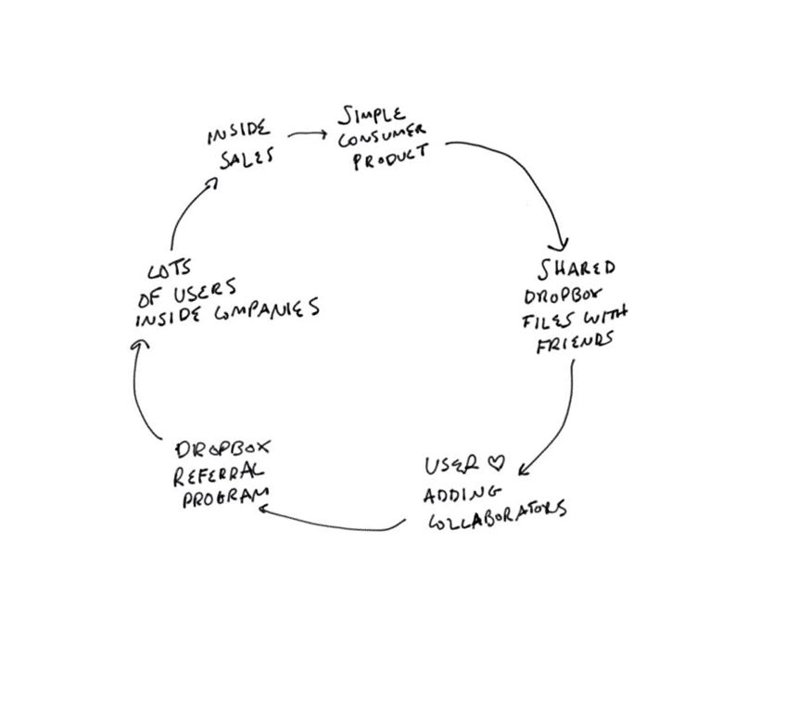
Example
GTM strategy:
Dropbox

Slide 37
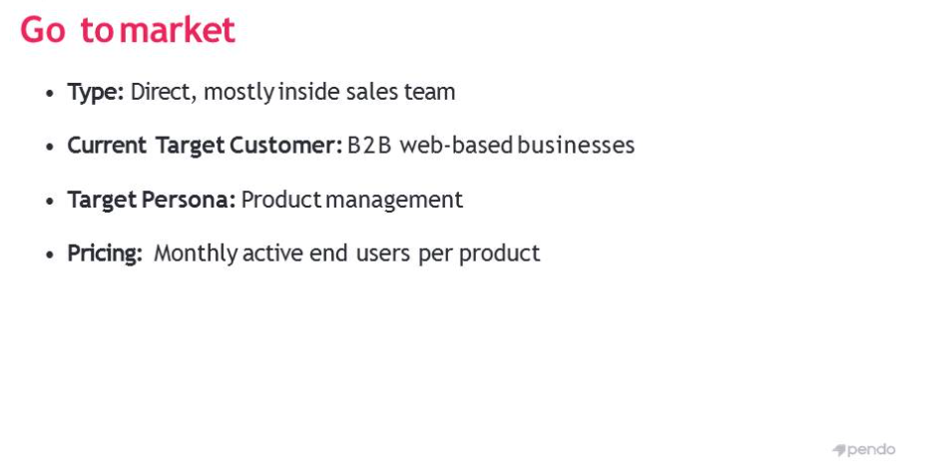

Example
GTM strategy:
Pendo

Slide 38
Example GTM strategy:
Worksheet

Slide 39
To recap
Invest in product, and build something customers love
Define your ideal buyer persona
Come up with your acquisition strategy // build your flywheel
Determine your payment model
Drive towards efficiency

Slide 40
How do I decide?
Deciding on the GTM strategy
This slide covers the benefits, cons and product characteristics of payment models, which can help decide overall GTM strategies.
But how do you do know which overall is right for you?
Many just experiment and see which channels/payment model/price works best.
At the end of the day, it’s about the customer.
Find the superusers, and figure out what makes them happy.

Slide 41
“The composition of your team and the priorities of your product org can be completely different based on your GTM strategy. Start early.”
- Amy Sun
Founder, ex Sequoia and Uber

Slide 42

You’ll be great!
As with most things in life, GTM strategy is messy and only formed through experiments. Don’t be afraid to experiment.

Slide 43
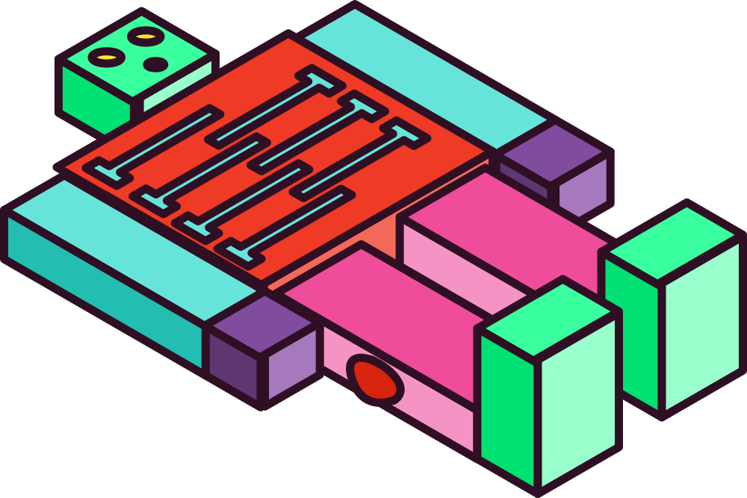
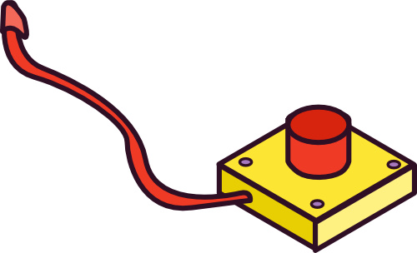
This deck is available only thanks to friends. Thanks to:
Number1gun (visuals), Gloria Pu (deck design), Ian Clark (pricing), John Wetenhall (GTM), Amy Sun (GTM).

Slide 44
Appendix: A brief glossary of terms
“Go to market” (GTM): A catchall phrase for all things post product development - marketing, sales, BD, pricing, etc.
Business to business (B2B): Businesses who sell to other businesses. A fancy word for business vs. consumer apps.
Software as a service (SaaS): Salesforce pioneered this - SaaS is generally two things: cloud services as opposed to on prem, and charging on a monthly basis instead of upfront contracts. It is an attractive model because monthly payments are consistent over time, instead of lumpy unpredictable contracts.
Buyer persona: Who your ultimate buyer is across many dimensions (role, title, responsibilities). There can be multiple buyer personas.
Willingness to pay (WTP): The measure for if, and how much, a user is willing to pay. Usually subjective, and not a number.

Slide 45
Appendix: A brief glossary of terms
Funnel: Stages of the marketing or sales process. For marketing, it is usually visitors > try to buy > convert to paid user. For sales it is prospect > demo > negotiation > paid customer.
Flywheel model: A new term that’s surfaced in the past few years. It is the antithesis to the traditional funnel model, where instead of a linear process, all aspects of the experience drive sales (product, customer experience, community, etc.)
Acquisition channels: Different ways to reach your users.
Search engine marketing (SEM): Bidding and buying ads for certain keywords when people enter them in Google search.
Search engine optimization (SEO): Creating content that shows up “organically” for certain keywords when people enter them in Google search.

Slide 46
Appendix: A brief glossary of terms
Demand generation: These roles own all acquisition channels (across marketing, sales, ops), but a lot of time they focus on SEM and SEO.
Freemium: A service that is free until a certain feature is wanted. For example, Notion charges once an user wants version history, or uploads a lot of files, etc.
Free trial: Charging users only until they’ve used the product for a predetermined amount of time. Usually a 7 day or 14 day free trial.
Paywall: Usually this is feature based, but a paywall is when an user has to pay for a feature.
Customer acquisition cost (CAC): The cost to acquire a new user. It combines costs of employees, martech, and acquisition spend. More relevant by the time you raise a Series A.

Slide 47
Appendix: A brief glossary of terms
Lifetime value (LTV): The average of how long an user pays you. For example, for an app where users on average stick around for a year, and whose users pay $5 a month, has a LTV of $60.
LTV/CAC ratio: Ideally you app pays very little to acquire customers who pay a lot and stick around for a long time. 3:1 is a good ratio, but the higher it is the better.

